Slide 1
DECOMPOSITION TECHNIQUES
Why?
Software project estimation is a form of problem solving, and in most cases, the problem to be solved (i.e., developing a cost and effort estimate for a software project) is too complex to be considered in one piece.

Slide 2
i. Software Sizing
The degree to which the planner has properly estimated the size of the product to be built;
The ability to translate the size estimate into human effort, calendar time, and dollars
The degree to which the project plan reflects the abilities of the software team
The stability of product requirements and the environment that supports the software engineering effort.

Slide 3
Different approaches to the sizing problem:
“Fuzzy logic” sizing.
This approach uses the approximate reasoning techniques
The planner must identify the type of application, establish its magnitude on a qualitative scale, and then refine the magnitude within the original range.
Function point sizing.
The planner develops estimates of the information domain characteristics

Slide 4
Standard component sizing.
Software is composed of a number of different “standard components” that are generic to a particular application area.
e.g. Information system are subsystems:
modules, screens, reports, interactive programs, batch programs, files,
Change sizing.
This approach is used when a project encompasses the use of existing software that must be modified in some way as part of a project.
The planner estimates the number and type
(e.g., reuse, adding code, changing code, deleting code)

Slide 5
ii. Problem-Based Estimation
LOC and FP data are used in two ways during software project estimation:
(1) as an estimation variable to "size" each element of the software and
(2) as baseline metrics collected from past projects and used in conjunction with estimation variables to develop cost and effort projections.

Slide 6
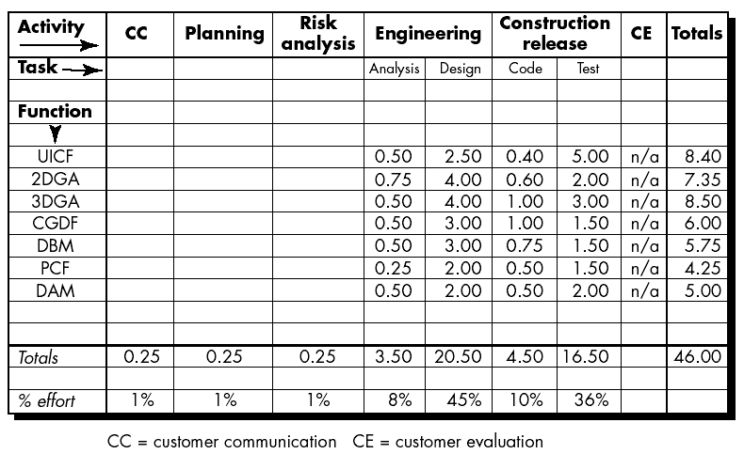
iii. Process-Based Estimation
Estimating a project is to base the estimate on the process that will be used.
The process is decomposed into a relatively small set of tasks and the effort required to accomplish each task is estimated.

Slide 7
Based on an average burdened labor rate of $8,000 per month, the total estimated project cost is $368,000 and the estimated effort is 46 person-months. If desired, labor rates could be associated with each software process activity or software engineering task and computed separately.

Slide 8
iii. EMPIRICAL ESTIMATION MODELS
Uses empirically derived formulas to predict effort as a function of LOC or FP.
a. The Structure of Estimation Models
E = A + B x (ev)^{C}
where A, B, and C are empirically derived constants, E is effort in person-months, and ev is the estimation variable (either LOC or FP).

Slide 9
LOC-oriented estimation models:
E = 5.2 x (KLOC)^{0.91} Walston-Felix model
E = 5.5 + 0.73 x (KLOC)^{1.16} Bailey-Basili model
E = 3.2 x (KLOC)^{1.05} Boehm simple model
E = 5.288 x (KLOC)^{1.047} Doty model for KLOC > 9
FP-oriented models:
E = -13.39 + 0.0545 FP Albrecht and Gaffney model
E = 60.62 x 7.728 x 10⁻⁸ FP³ Kemerer model
E = 585.7 + 15.12 FP Matson, Barnett, and Mellichamp model

Slide 10
Basic COCOMO Model
COCOMO II is actually a hierarchy of estimation models that address the following areas:
Application composition model.
Used during the early stages of software engineering, when prototyping of user interfaces, consideration of software and system interaction, assessment of performance, and evaluation of technology maturity are paramount.
Early design stage model.
Used once requirements have been stabilized and basic software architecture has been established.
Post-architecture-stage model.
Used during the construction of the software.

Slide 11
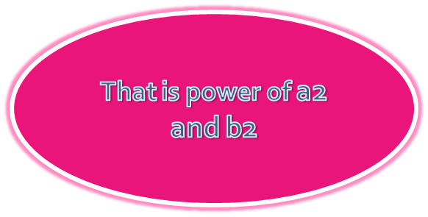

Basic COCOMO Model
Organic: Developing well understood application programs, small experienced team
Semi Detached: mix of experienced and non experienced team, unfamiliar
Embedded: strongly coupled to computer hardware
Basic CoCoMO
Effort = a₁ (KLOC)a2 PM
Time = b₁ (Effort) b₂ Months
where a₁ a₂ b₁ b₂ are constants

Slide 12
Basic COCOMO Model
Power
Basic CoCoMO
Effort = a₁ (KLOC) a₂ PM
Time = b₁ (Effort) b₂ Months
where a₁ a₂ b₁ b₂ are constants
Effort a₁ a₂
Organic 2.4 1.05
Semidetached 3.0 1.12
Embedded 3.6 1.20
Effort b₁ b_{2_____}
Organic 2.5 0.38
Semidetached 2.5 0.35
Embedded 2.5 0.32

Slide 13
Basic COCOMO Model
The size of an organic software is estimated to be 32,000 LOC. If the average salary of software engineering is Rs. 15000/- per month. What will be effort and time for the completion of the project?
Effort=?

Slide 14
Basic COCOMO Model
The size of an organic software is estimated to be 32,000 LOC. If the average salary of software engineering is Rs. 15000/- per month. What will be effort and time for the completion of the project?
Effort=2.4 * (32)^{1.05} PM

Slide 15
Basic COCOMO Model
The size of an organic software is estimated to be 32,000 LOC. If the average salary of software engineering is Rs. 15000/- per month. What will be effort and time for the completion of the project?
Time = ?

Slide 16
Basic COCOMO Model
The size of an organic software is estimated to be 32,000 LOC. If the average salary of software engineering is Rs. 15000/- per month. What will be effort and time for the completion of the project?
Time = 2.5 * (91)^{0.38} Months
Cost = ?
Cost = 14*15000=210000

Slide 17
Intermediate COCOMO Model
Basic COCOMO:
Effort /Development time are functions of product size alone
However other parameters also exist:
Product => Complexity
Computer => Execution speed, storage
Personnel => Experience level
Development Environment => CASE tool

Slide 18
Advanced COCOMO Model
Defects of Basic and Intermediate CoCOMO:
Considers software product as a single homogenous entity
But large systems are composed of several smaller subsystems
Effort + Development time = Sum of estimates of individual Subsystems
Cost of each subsystem estimated separately!!

Slide 19
Advanced COCOMO Model
NCIT MIS
Database Component
GUI Component
Communication Component
Semi Detached
Organic
Embedded

Slide 20
c. The Software Equation
E = [LOC - B^{0.333}/P]³ - (1/t⁴)
      Where,
      E = effort in person-months or person-years
      t = project duration in months or years
      B = “special skills factor”16
      P = “productivity parameter” that reflects:
      • Overall process maturity and management practices
      • Extent to which good software engineering practices are used
      • The level of programming languages used
      • The state of the software environment
      • The skills and experience of the software team
      • The complexity of the application

Slide 21
c. The Software Equation
A dynamic multivariable model that assumes a specific distribution of effort over the life of a software development project.
Derived from productivity data collected for over 4000 contemporary software projects.

